Slide 1
NAME-400 Project & Thesis
Supervised by,
Dr. N. M. Golam Zakaria
Professor,
Dept. of NAME,
BUET.
Presented by,
Touseef Hasan
Student ID: 1812044,
Shamsul Islam
Student ID: 1812039.

Slide 2
Tentative Title
“A Material Flow Analysis of the Ship-Breaking Industry in Bangladesh
using Machine Learning.”

Slide 3
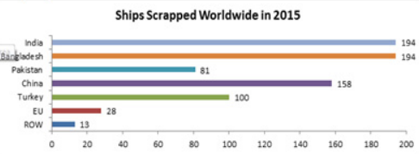
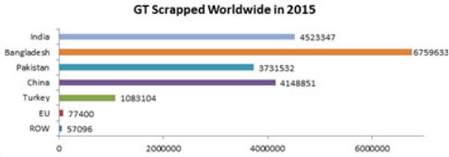
Background Study
1. 30% of the global ship recycling volume. (Grey, 2012)

Slide 4
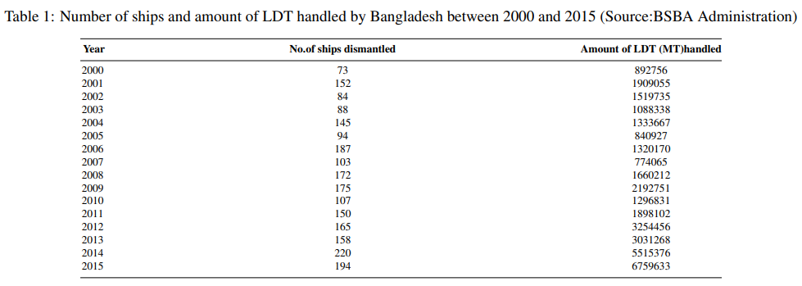
Background Study (contd.)

Slide 5
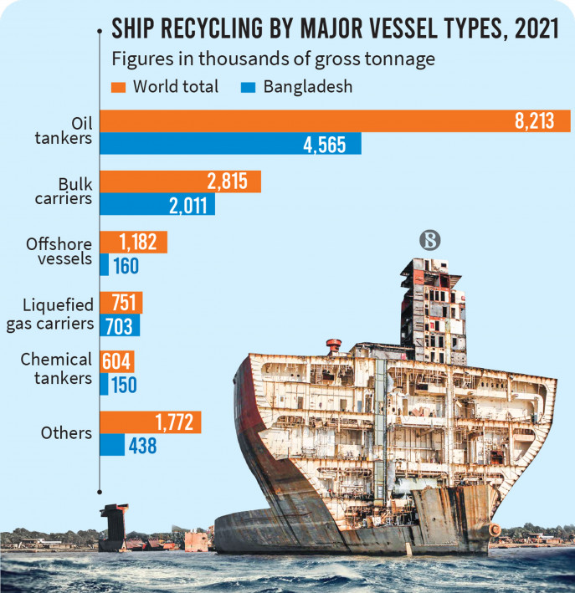
Background Study (contd.)

Slide 6
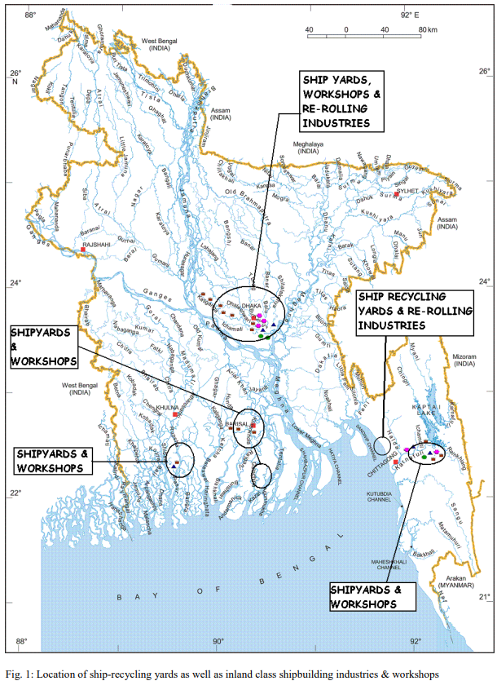
Background Study (contd.)
2. 149 registered breaking yards in 2014-15.
(Shameem, 2015)
More than 100 of those are located in
Sitakund, Chattogram.

Slide 7
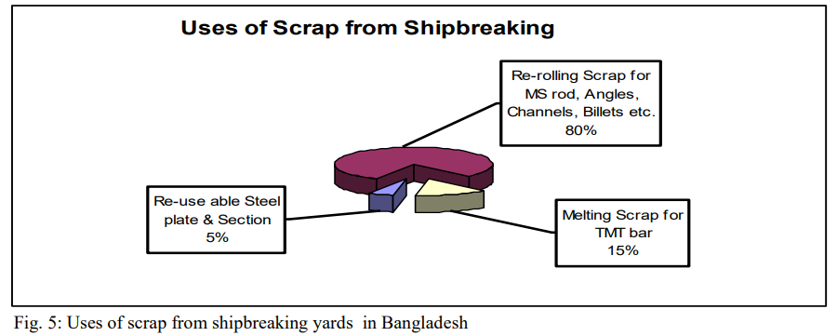
Background Study (contd.)
3. 85% of the total weight comprises recyclable steel. (Sujauddin, 2015)

Slide 8
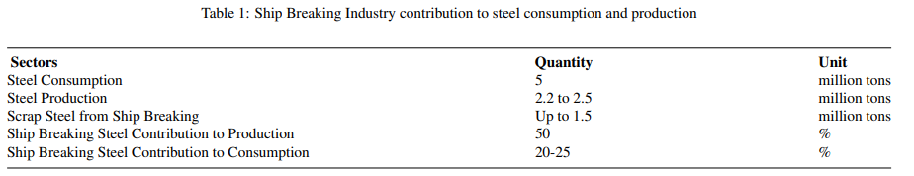
Background Study (contd.)
4. 80-90% steel is derived from end-of-life ships. (Hasan, Aevelina, 2016)
5. 5 million tons of steel/year are required for local consumption.

Slide 9
Objectives
1. Review the ship-breaking industry in Bangladesh, considering its
economic, environmental, and social aspects.
2. Develop a machine learning model, using key factors – ship type,
market conditions, and historical data to predict the scrap value of
ships.
3. Conduct gap analysis and provide a projection of ship scrap, based on
relevant input parameters.

Slide 10
Methodology
1. Reviewing Existing Literature
2. Data Collection, Pre-processing and Exploratory Data Analysis (EDA)
3. Feature Engineering
4. Machine Learning Model Development, Training & Validation
5. Model Evaluation and Interpretation

Slide 11
Progress
1. Literature Review and Gap Analysis
→ Absence of valid parameters/key factors in the estimation
→ Small sample size of a few ship types
→ Inaccurate distribution of Light Displacement Tonnage (LDT)

Slide 12
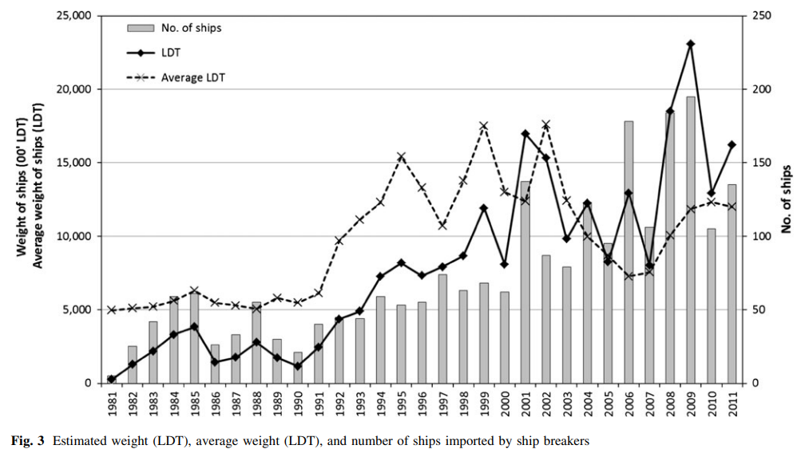
Progress (contd.)

Slide 13
References
Hossain, A., Iqbal, K.S. and Zakaria, N.M.G.; Ship Recycling Prospects in Bangladesh, December, MARTEC 2010, Bangladesh
Shameem, A.B.M; The Role of the Ship Breaking Industry in Bangladesh and its Future with Special Emphasis on Capacity Building Through Education and Training, M.Sc Thesis, 2012, World Maritime University, Sweden
Rahman, Sohanur; Aspects and Impacts of Ship Recycling in Bangladesh, MARTEC 2016
N. M. Golam Zakaria, Mir Tareque Ali and Kh. Akhter Hossain; Underlying Problems of Ship Recycling Industries in Bangladesh and Way Forward, Journal of Naval Architecture and Marine Engineering, December, 2012
Hasan Ruhan Rabbi, Aevelina Rahman; Ship Breaking and Recycling Industry of Bangladesh; Issues and Challenges, MARTEC 2016
Sujauddin, M., R. Koide, T. Komatsu, M. M. Hossain, C. Tokoro, and S. Murakami. 2015. Characterization of ship breaking industry in Bangladesh. Journal of Material Cycles and Waste Management
Sujauddin, M., R. Koide, T. Komatsu, M. M. Hossain, C. Tokoro, and S. Murakami. 2017. Ship Breaking and the steel industry in Bangladesh; A Material Flow Perspective

Slide 14
Thank You.

